Slide 1

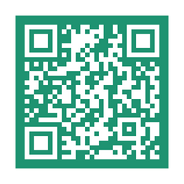






SWITCH YOUR TRIPS WA
Leave the car at home during October and reap the benefits of trying other modes of transportation! Complete and log at least ten trips using a qualifying travel option and be automatically entered to win amazing prizes.
Oct.
1-31
$1,500 GRAND PRIZE
$500, $250, $75, $50 prizes, $25 social media prizes, and more!
Learn more at SwitchYourTripsWA.com
Eligible modes include: Carpool, vanpool, bus, train, light rail, foot ferry, bicycle, walking, rolling, skateboarding.
Qualifying trips include: Commutes, errands, and any trip where you would have usually driven alone but are instead choosing a sustainable trip mode. You must be traveling to and from a destination.
YOUR TRIPS
SWITCH

